Slide 1

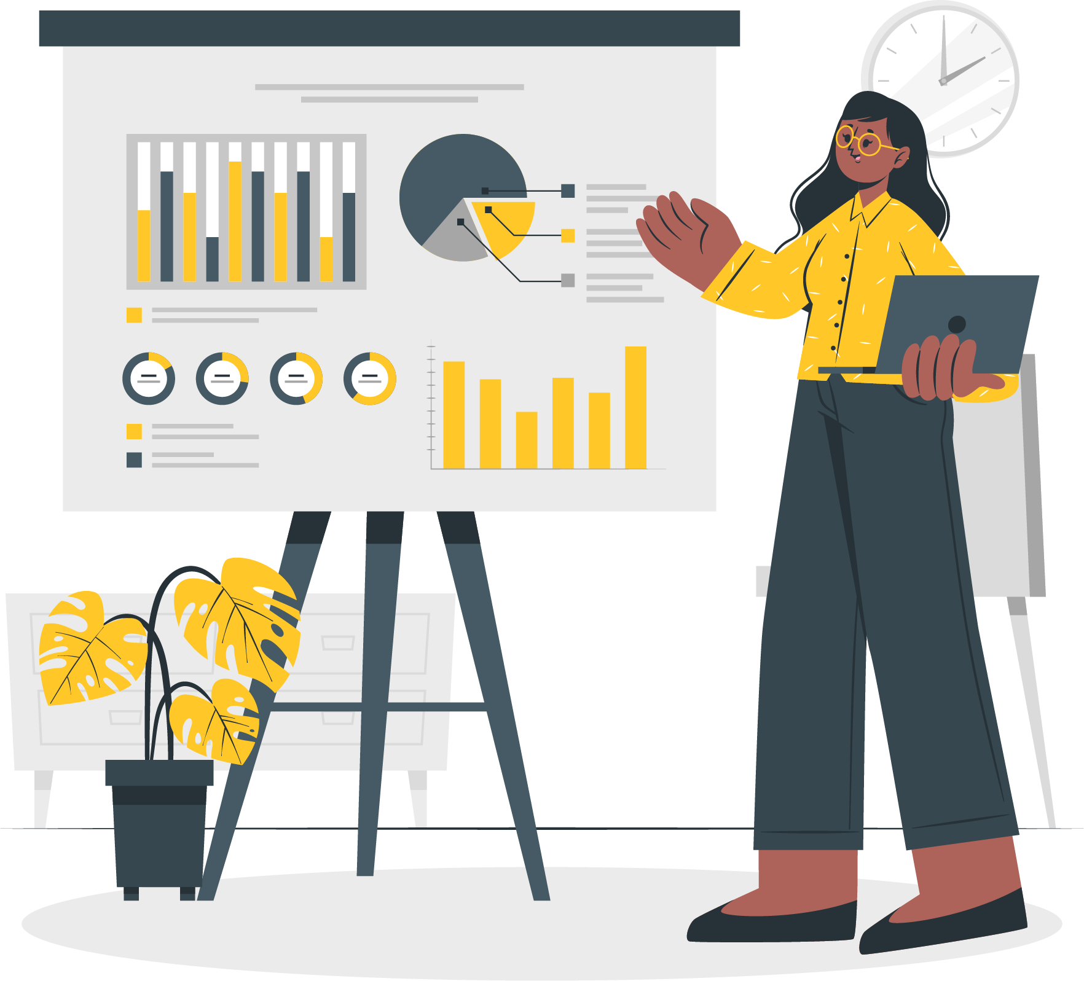
SLIDE PRESENTASI PROJEK MANDIRI
1

Slide 2
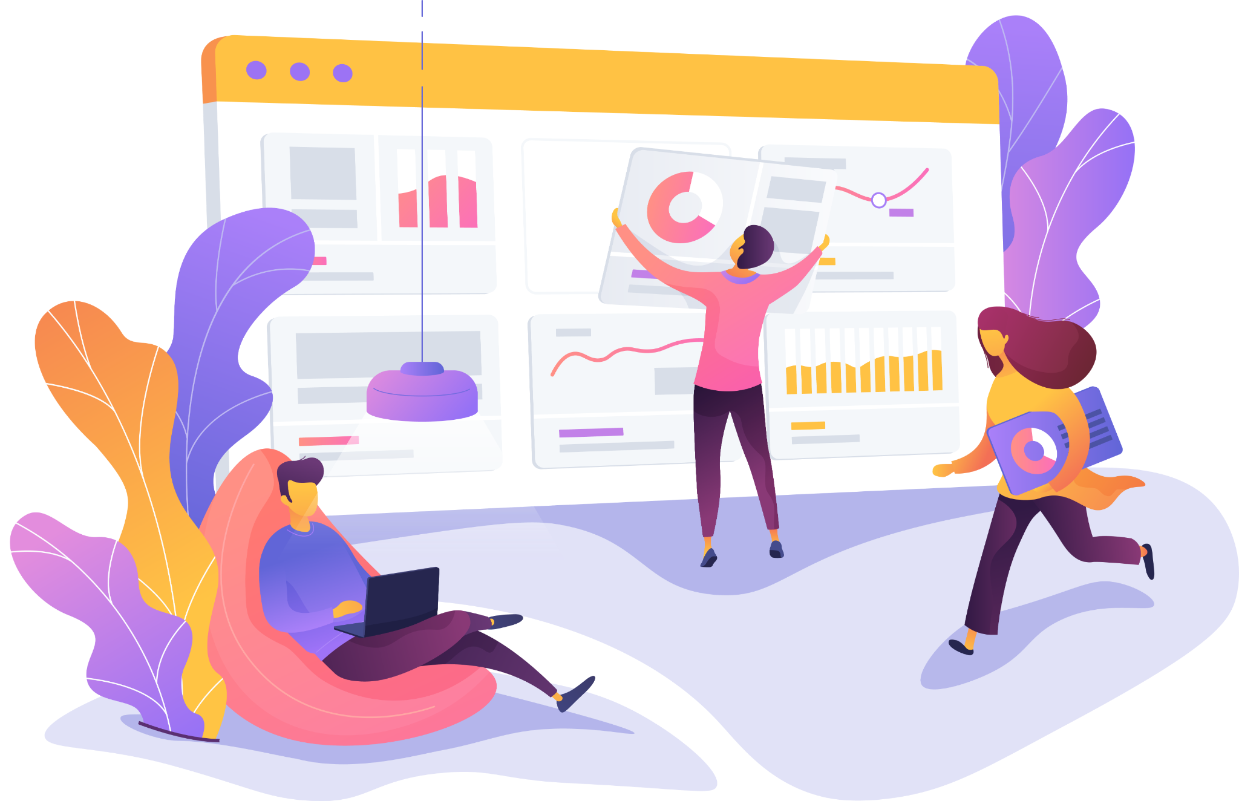
CAPSTONE PROJECT Data Scientist
Customer Segmentation 2 (Clustering 2)
Teuku Raihan Hariyansyah
2

Slide 3
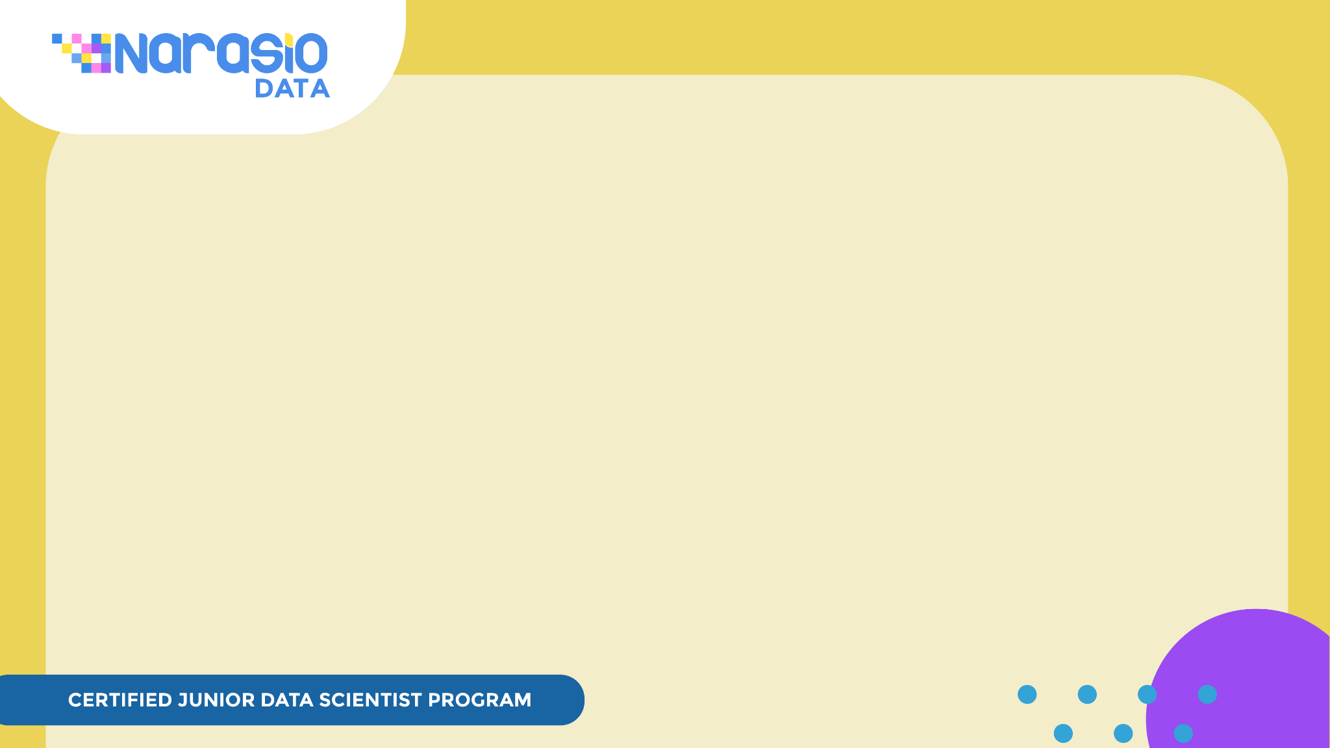
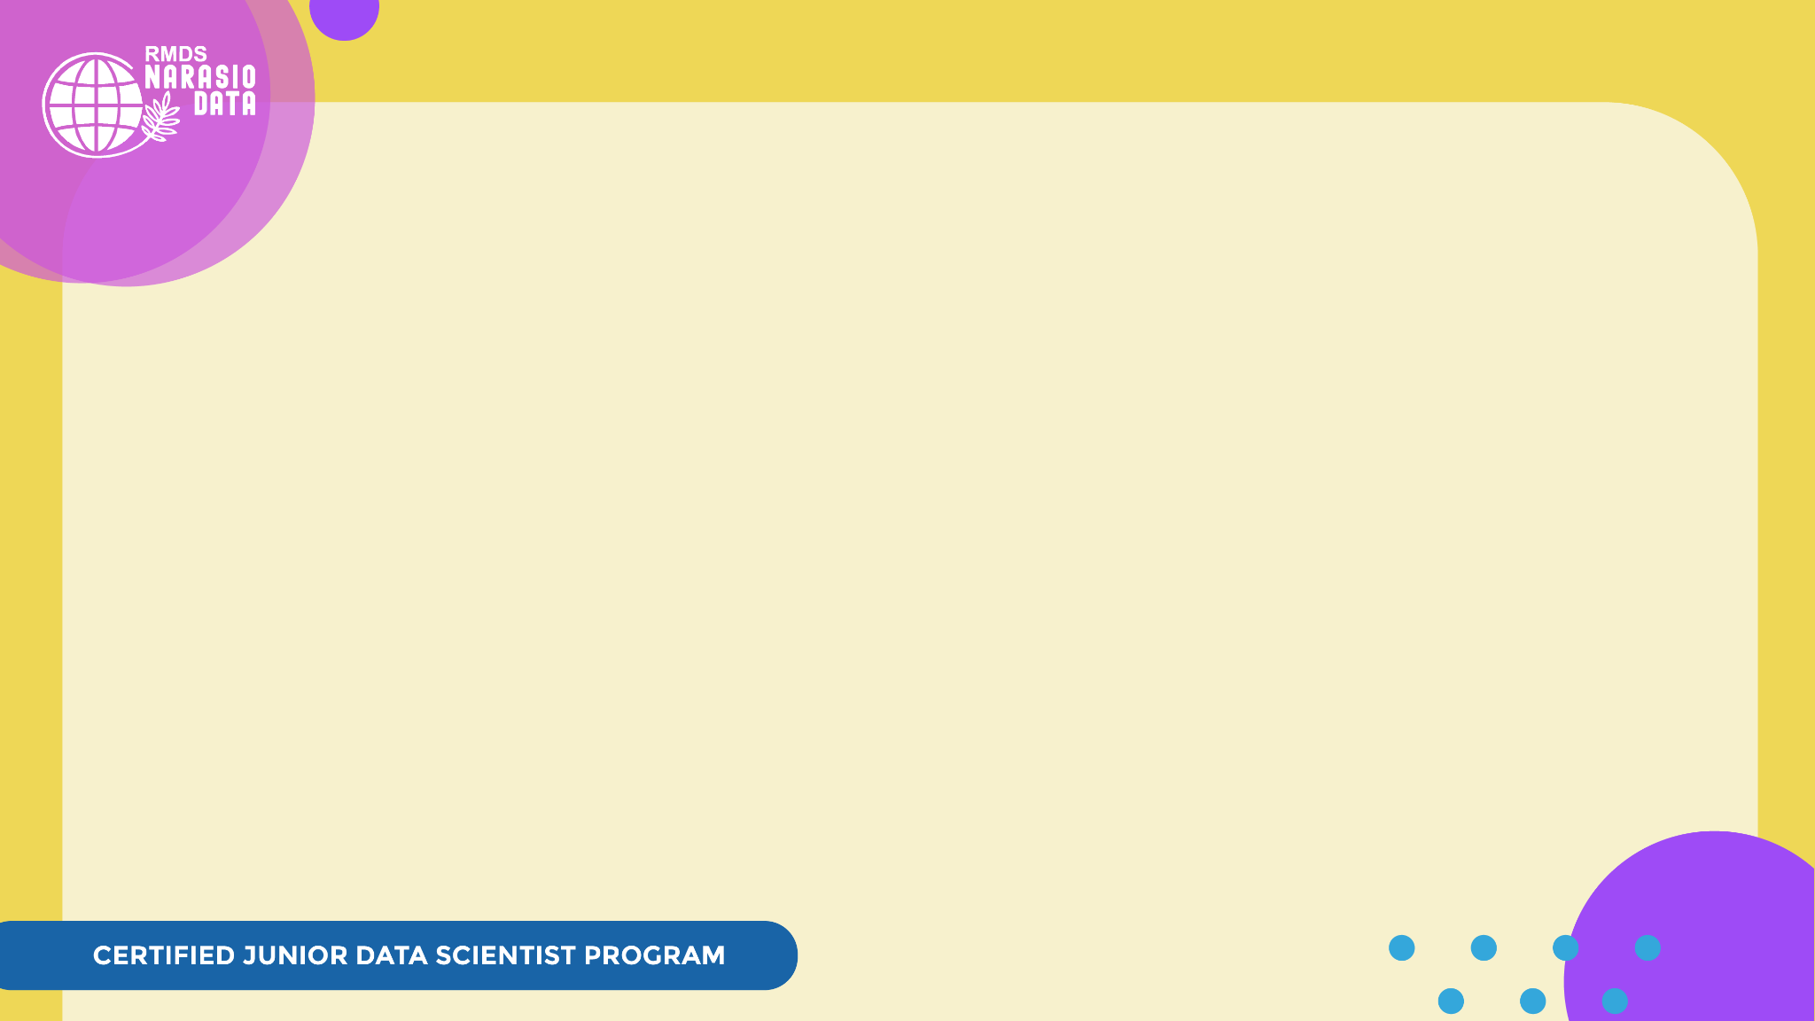
READ ME!
In this capstone project presentation, we expect you to share not only the final result of your project but also the learning process you get from #SDSNarasioData
Things we want you to notice:
This is only a guideline, means you’re free to answer more questions to enrich your presentation, but remember that your showcase time is only 12 minutes.
Make a copy of this document before editing
Feel free to add more things on this slide, picture, screenshot, anything!
Skip this README slide when you’re about to present your work
3

Slide 4
My Project Background
(Business Problem)
Problem | How to Solve
Want to create 3 segmentation, which are Platinum Customers, Gold Customers, and Silver Customers according to their shopping frequency and spending | We can use clustering method to make a segmentation according to its frequency and monetary with RFM Method
Want to give a promo’s to customers according to their shopping frequency and spending
4

Slide 5
Method & Workflow Project
Method used
RFM Analysis
Workflow
Read Dataset
EDA
Data Pre-processing
RFM Analysis
Modeling
5

Slide 6
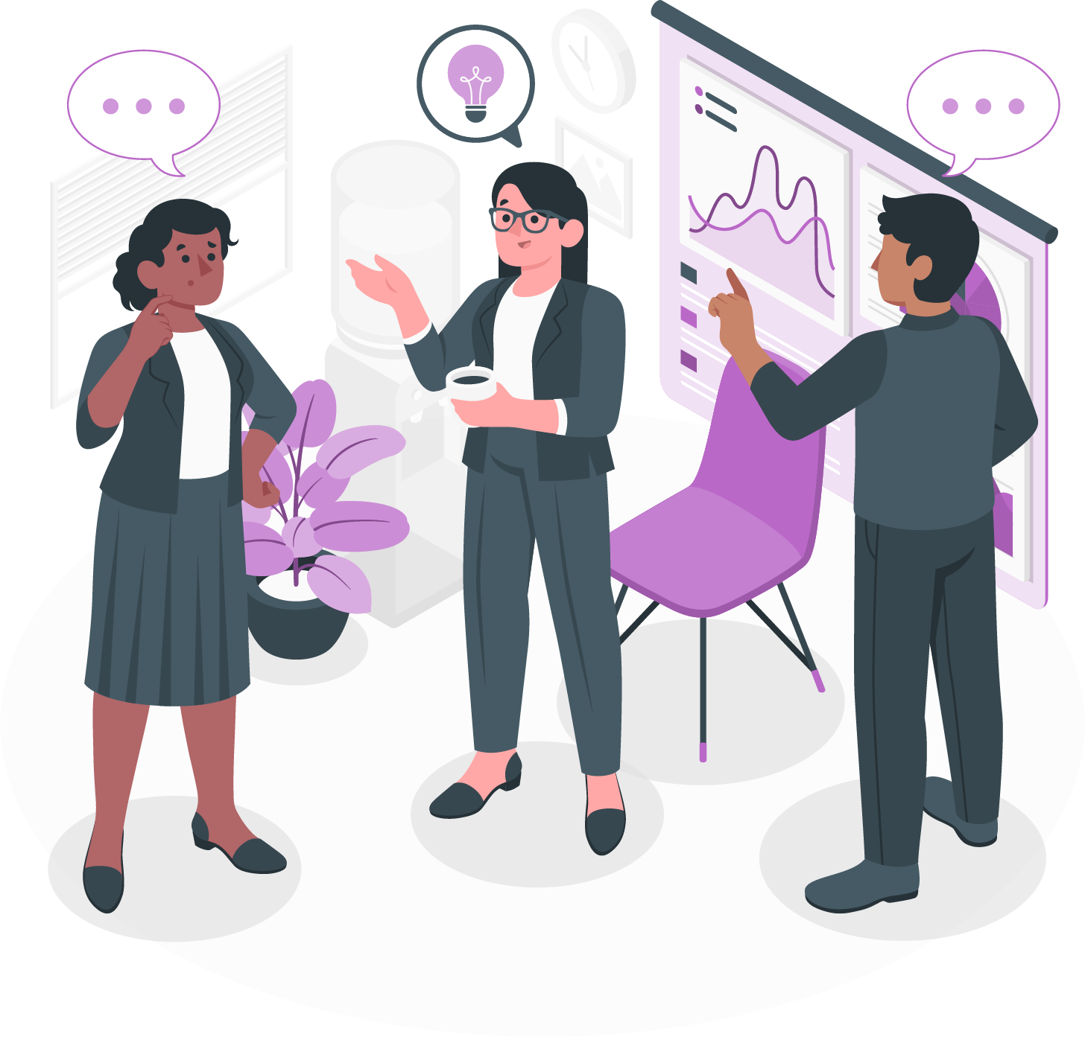
Demo Time!
6

Slide 7
Demo Time!
Note
Please mention the following points in your demo presentation:
Workflow Project
EDA
Method
Feature engineering/preprocessing
Modelling and Evaluation
Conclusion
Skip this slide when you’re about to present your work
7

Slide 8
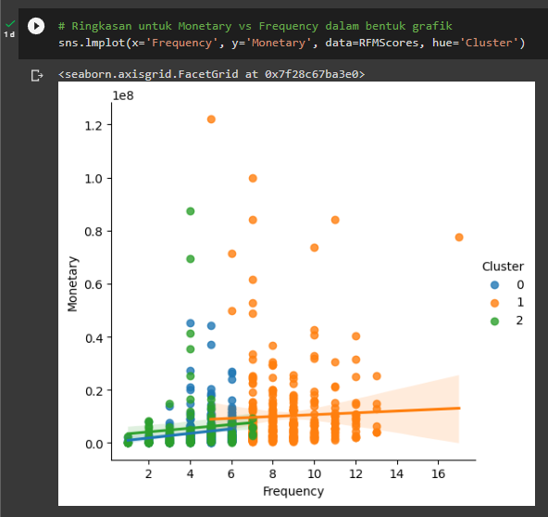
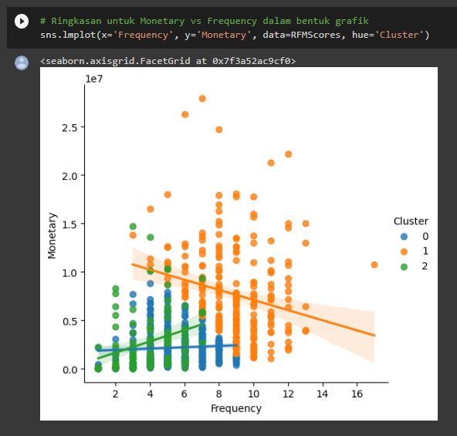
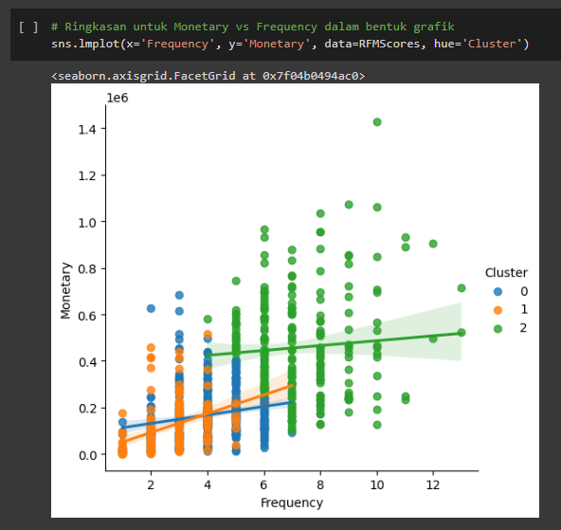
Result of Project and Recommendations
Frequency
vs
Monetary
No Handling Outlier
One times Handling Outlier
Two times Handling Outlier
Segmentasi tidak terlihat
Segmentasi terlihat
Segmentasi lebih terlihat
Ada sekitar 40% data hilang
8

Slide 9
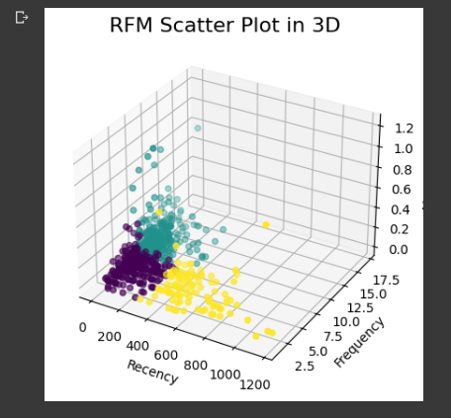
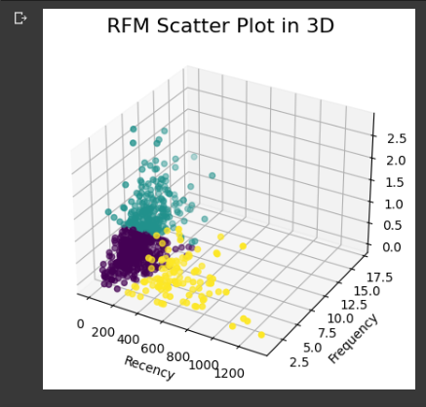
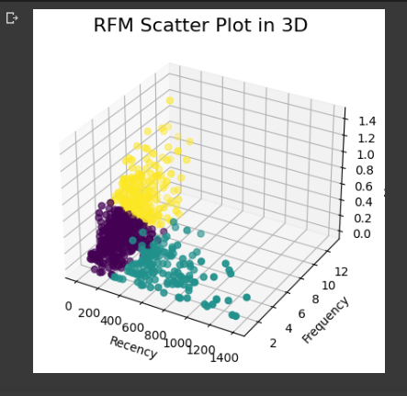
RFM 3D
Scatter Plot
Result of Project and Recommendations
No Handling Outlier
One times Handling Outlier
Two times Handling Outlier
9

Slide 10
Learning Takeaways
What learning do I get from working on this project?
How to process and analyze data from the beginning
How to handling a problem during processing data
What other learning do I feel throughout my journey in #SDSNarasioData?
Time Management
Structured work
Learn a new thing
New Experience as a Data Scientist
10

Slide 11

THANK YOU!
11

